Slide 1
Propositional Logic
CSI 219 – Discrete Mathematics
Course teacher: Minhajul Bashir

Slide 2

Quick review problem
Prove or disprove the following equivalence using truth table:
$$p→q≡¬p∨q$$

Slide 3
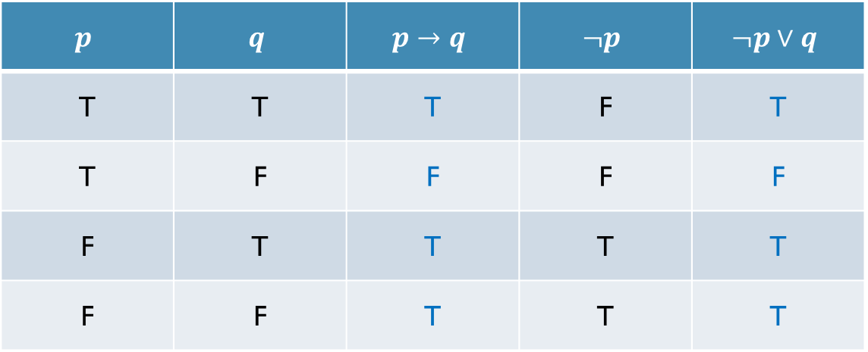

$p→q≡¬p∨q$???
$$p$$ | $$q$$ | $$p→q$$ | $$¬p$$ | $$¬p∨q$$
T | T | T | F | T
T | F | F | F | F
F | T | T | T | T
F | F | T | T | T

Slide 4

Can we intuitively say $p→q≡¬p∨q$???

Slide 5
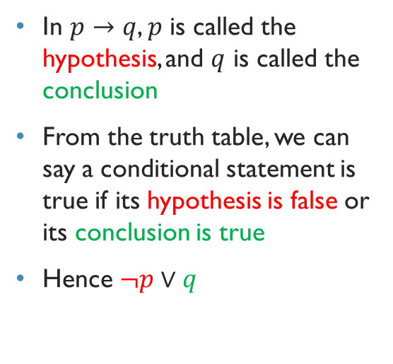
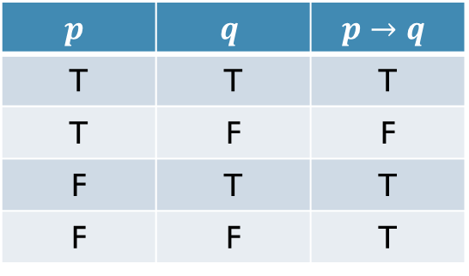
$p→q≡¬p∨q$???
In $p→q$, $p$ is called the hypothesis, and $q$ is called the conclusion
From the truth table, we can say a conditional statement is true if its hypothesis is false or its conclusion is true
Hence $¬p∨q$
$$p$$ | $$q$$ | $$p→q$$
T | T | T
T | F | F
F | T | T
F | F | T

Slide 6
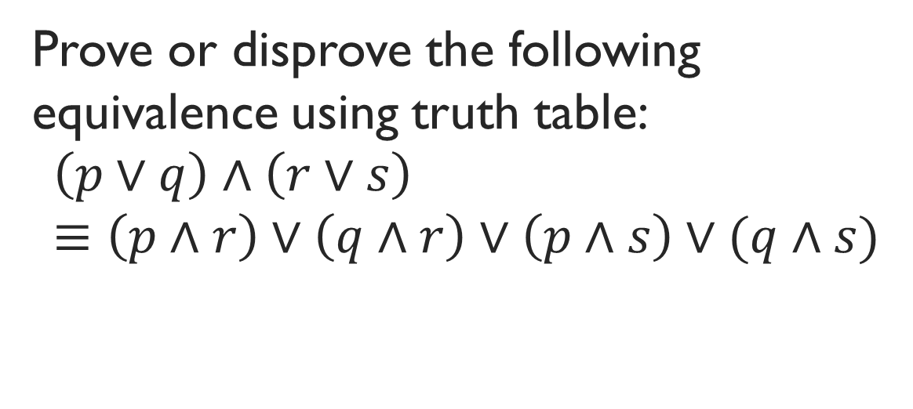
Problems of using truth table for verifying equivalence
Prove or disprove the following equivalence using truth table:
$$\left(p∨q\right)∧\left(r∨s\right)≡\left(p∧r\right)∨\left(q∧r\right)∨\left(p∧s\right)∨(q∧s)$$

Slide 7
Another way to verify equivalence
We remember some important equivalences
We use them to verify any given equivalence

Slide 8


Important logical equivalences
Identity
Domination
$$p∧T≡p$$
$$p∨F≡p$$
$$p∨T≡T$$
$$p∧F≡F$$

Slide 9


Important logical equivalences
Idempotent
Double negation
$$p∧p≡p$$
$$p∨p≡p$$
$$¬\left(¬p\right)≡p$$

Slide 10


Important logical equivalences
Commutative
Associative
$$p∨q≡q∨p$$
$$p∧q≡q∧p$$
$$\left(p∨q\right)∨r≡p∨\left(q∨r\right)$$
$$\left(p∧q\right)∧r≡p∧(q∧r)$$

Slide 11

Important logical equivalences
Distributive
$$p∨\left(q∧r\right)≡\left(p∨q\right)∧\left(p∨r\right)$$
$$p∧\left(q∨r\right)≡\left(p∧q\right)∨(p∧r)$$

Slide 12

Important logical equivalences
De Morgan’s law
$$¬\left(p∧q\right)≡¬p∨¬q$$
$$¬\left(p∨q\right)≡¬p∧¬q$$

Slide 13


Important logical equivalences
Absorption
Negation
$$p∨\left(p∧q\right)≡p$$
$$p∧\left(p∨q\right)≡p$$
$$p∨¬p≡T$$
$$p∧¬p≡F$$

Slide 14



Important logical equivalences
Conditional
Contrapositive
$$p→q≡¬p∨q$$
$$p→q≡¬q→¬p$$
Biconditional
$$p↔q≡\left(p→q\right)∧(q→p)$$

Slide 15

Example: Prove that $¬\left(p→q\right)≡p∧¬q$
Rosen, page 26, example 6

Slide 16
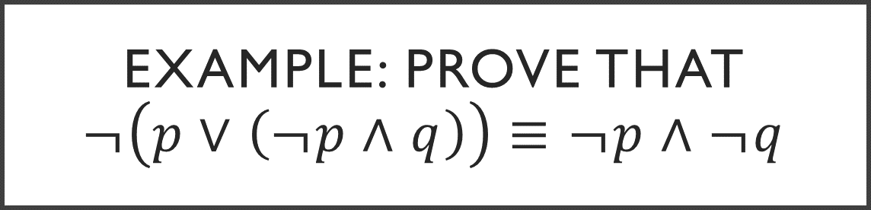
Example: Prove that $¬\left(p∨\left(¬p∧q\right)\right)≡¬p∧¬q$
Rosen, page 26, example 7

